Slide 1
Introduction to SQL Databases
Introduction to Databases and SQL (Day 2)
Notes:
Photo by Mark König on Unsplash

Slide 2
Lesson Outcome
By the end of today, you should be able to:
Understand the basics of databases and their role in backend development
Explain what SQL is and its importance in data management
Create and query a database using SQL
Understand the principles of database design and entity-relationship diagrams

Slide 3

Introduction to Databases
Think of a library. In this analogy, the library is filled with numerous books, newspapers, magazines, and DVDs. A database is like the library - a structured set of data.
The different types of data (books, newspapers, etc.) can be compared to different types of data stored in a database, such as text, numbers, dates, and more.

Slide 4

Introduction to SQL
SQL (Structured Query Language): A standard language for interacting with databases.
Purpose: Retrieve, insert, update, and delete data stored in a database.
Universality: Used across various database systems (MySQL, PostgreSQL, SQLite, etc.).
Design: Highly structured and rule-based, allowing precise and efficient data management.

Slide 5
Tables, Rows, and Columns in SQL
In SQL, data is organized into tables, with each table representing a specific entity (like 'Users', 'Orders', etc.). Each table consists of rows and columns.
Imagine a school register:
Columns are things like ‘Name’, ‘Class’, ‘Roll Number’, ‘Attendance’, etc.
Each row is a single entry of a student registration record. The columns of that row contain the specific details of that student.
SQL allows you to efficiently store, manage and retrieve data in a database.

Slide 6
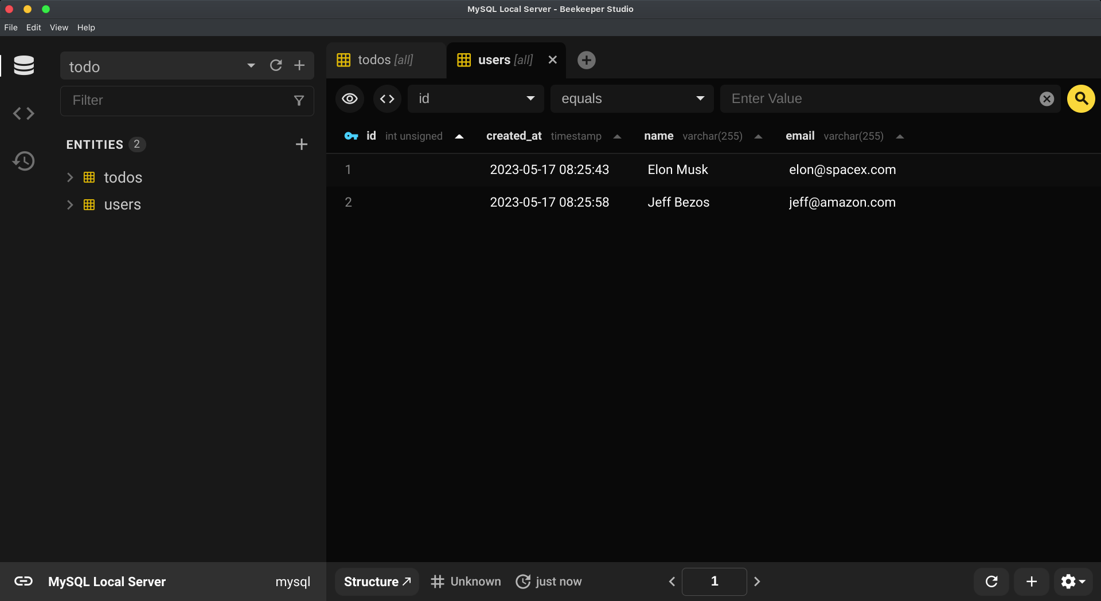
Tables, Rows, and Columns in SQL: Users Table

Slide 7
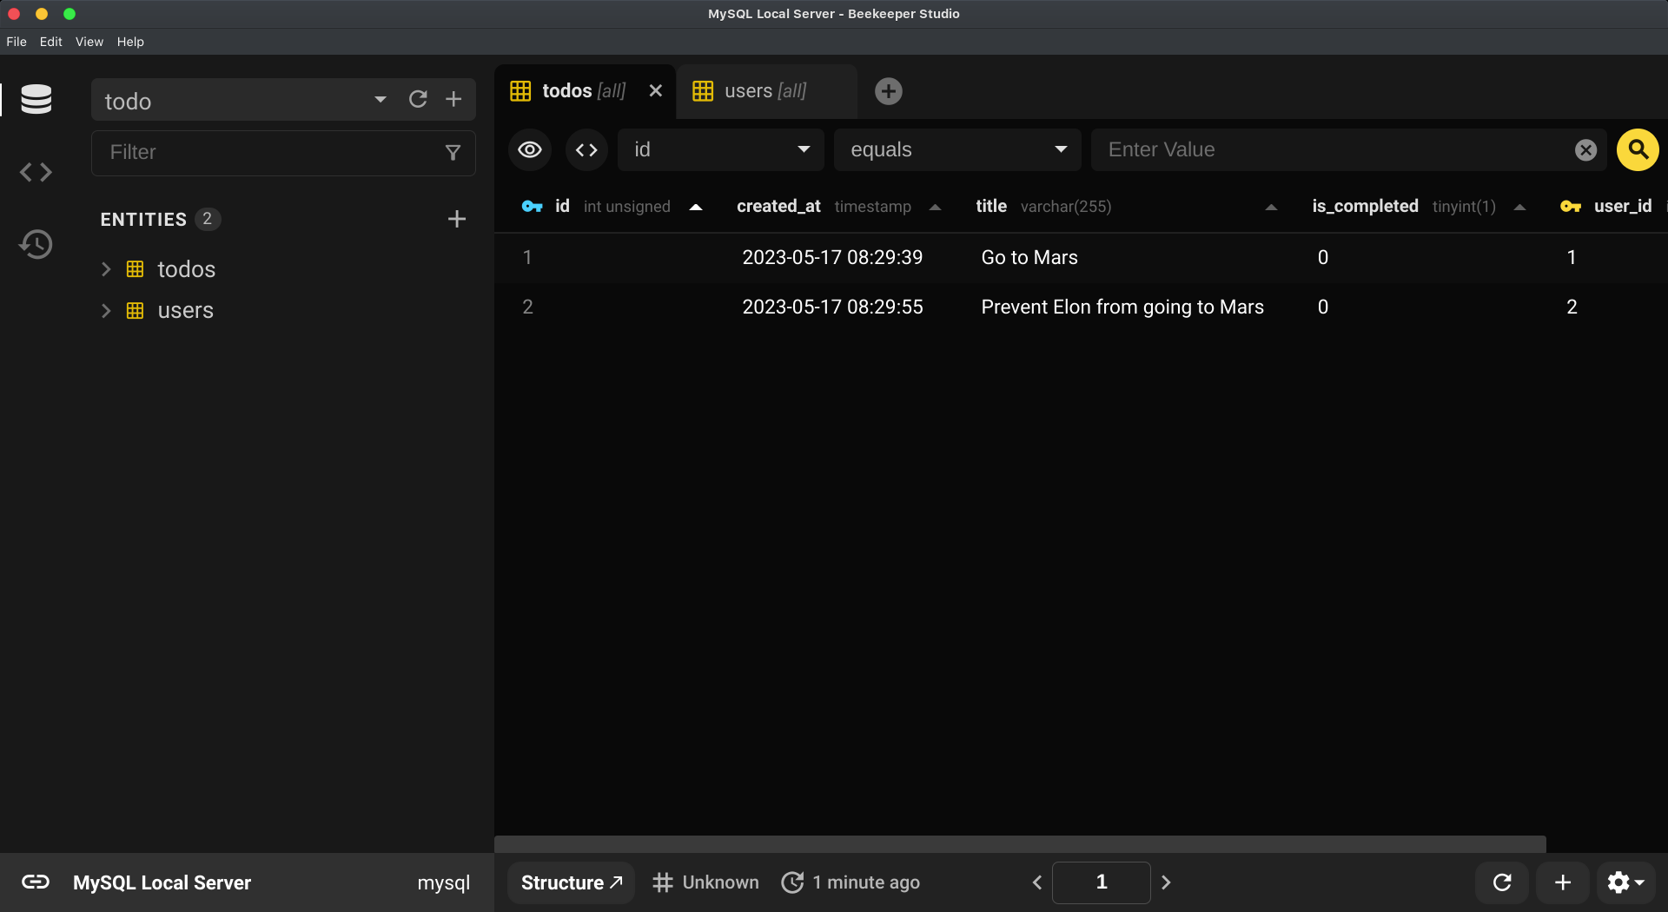
Tables, Rows, and Columns in SQL: Todos Table

Slide 8
Tables, Rows, and Columns in SQL
From the previous diagrams:
The users table represent users in the database. Each user is a row. Each row contains an information of that user.
The todos table represent todos that belong to the specific user. You will notice that we have a user_id column in the todo row so that we can associate a todo to a single user. This will create what known as one-to-many relationship entity in database. One to many relationship is when an entity has a relationship to other entities. In this case, a user can have multiple todos and a todo must have one user. More on this later

Slide 9
Basic SQL commands
SELECT: get row(s) from a table
INSERT: add new row(s) to a table
UPDATE: change existing row(s) in a table
DELETE: remove row(s) from a table

Slide 10
Applications to Install
We're going to use Docker to create a separate MySQL database. This way, our development process is independent from our main system. If we make mistakes, we can just delete the Docker container and start over.
Follow this link to install Docker.
Follow this link to spin up a MySQL server with Docker.
You should also install Beekeeper Studio. This tool will allow us to conveniently connect to our database and interact with it through a user-friendly graphical interface. We use Beekeeper Studio because it offers a user-friendly graphical interface (GUI), simplifies creating, reading, updating, and deleting (CRUD) tables or databases, and allows you to visualize your data easily.

Slide 11
Connecting to MySQL Database Using Beekeeper
Open Beekeeper Studio
Create a New Connection: On the welcome screen, click on the "Connect" button to start setting up a new connection.
Select MySQL as Database Type
Input Connection Settings: Enter the following details:
Host: Since you are running the MySQL server on your local machine, use localhost or 127.0.0.1 as your host.
Port: You have mapped your Docker MySQL container's 3306 port to 3306 on your host machine. Therefore, enter 3306 as the port.
Username: You are using the root user to connect, so enter root as the username.
Password: The password you have set is sigma12345. Enter this as the password.
Database: If you have a specific database you want to connect to, enter its name here. You can leave it blank if you just want to connect to the server.
Test and Save the Connection: You can click on "Test Connection" to ensure the details are correct. If the connection is successful, save it for quick access in the future.
Connect: Finally, click on the "Connect" button.

Slide 12
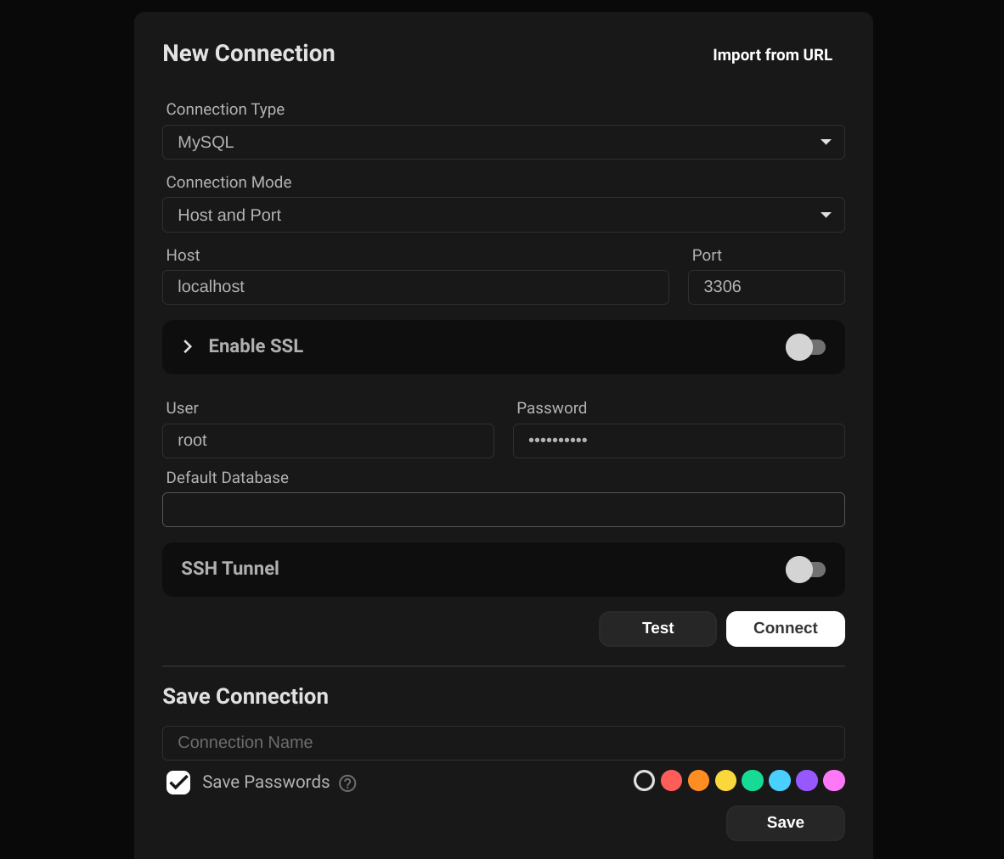
Connecting to MySQL Database Using Beekeeper

Slide 13
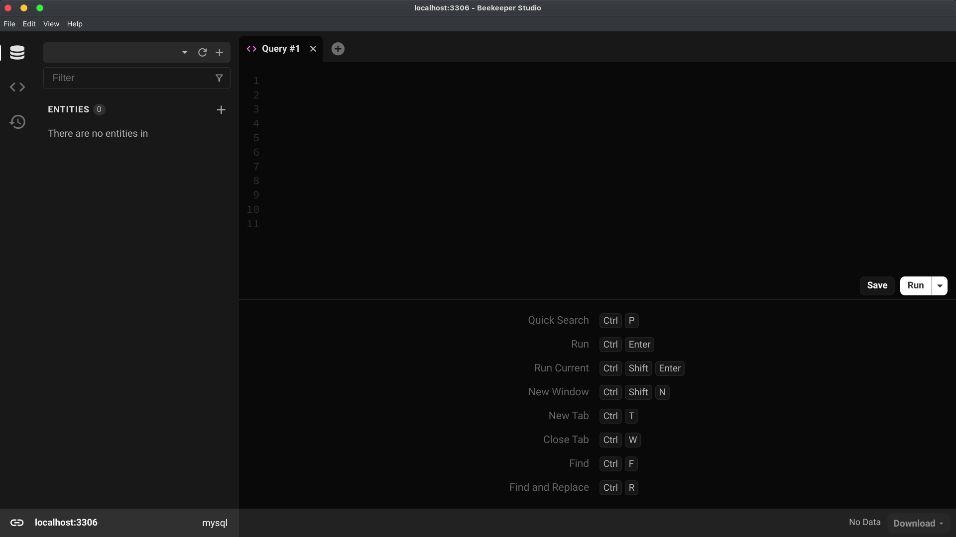
You should see something similar to this…

Slide 14
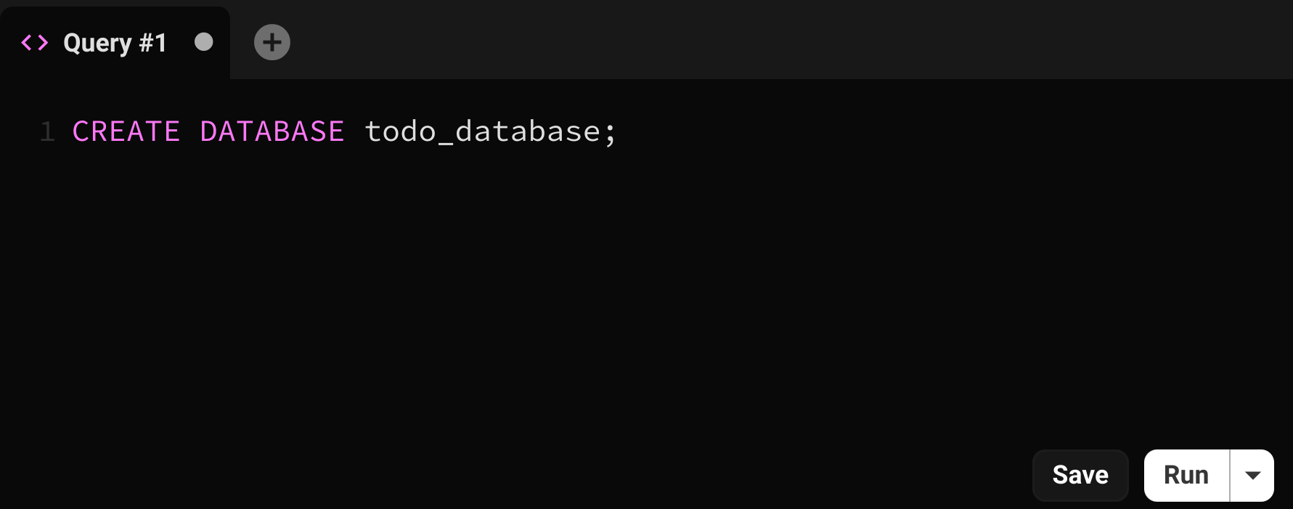
Creating a database in MySQL
The first step in working with SQL is to create a database. The command is simple: CREATE DATABASE myDatabase;. Replace "myDatabase" with the name you choose for your database.
In Beekeeper Studio, to execute a command you can either hit CTRL + Enter or click run at the middle right.

Slide 15
Commands?
What you just did was, you executed a command. In SQL, a command ends with semicolon (“;”). You can use SQL commands to do pretty much everything with the database.
In previous example, we wrote a command to create a new database but we haven’t run (executed) it. To run it, you can either hit CTRL + Enter or click run button at the middle right.

Slide 16
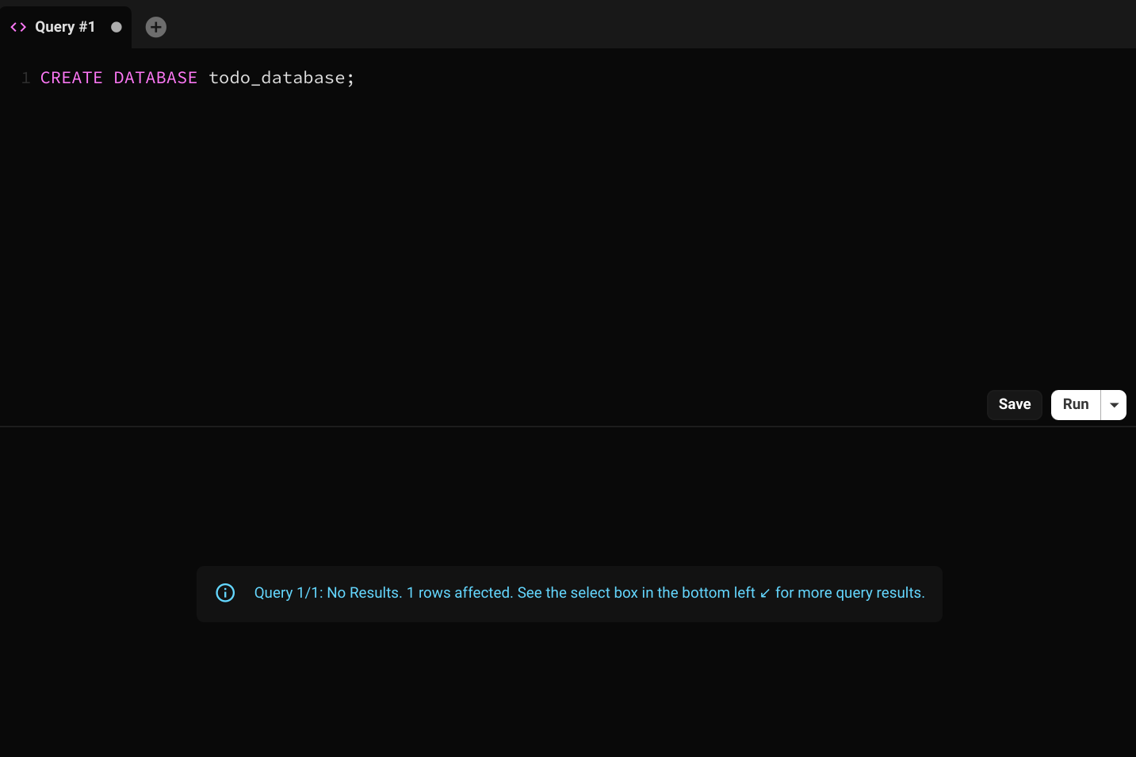
After running a command…
The result is successful. If you see anything that’s red, that means an error occurred.

Slide 17
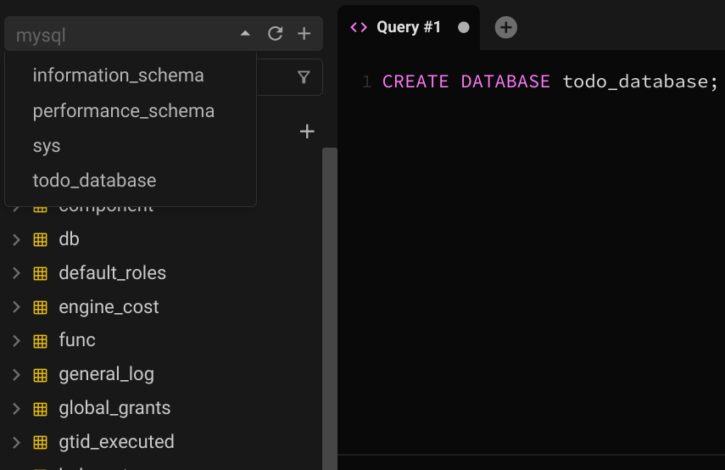
Switch to the newly created database
In SQL, you can have multiple databases.
Each database contains tables.
Let’s select the database we just created by selecting it in the dropdown at the top left.

Slide 18
Creating a table in MySQL
So we have a database, let’s create some tables to build a simple todo database.
Before we write commands, it’s important to translate the schema (table structure) into real-world.
For a simple todo app, how many tables do we need? What are the fields/column should each table have?

Slide 19
Creating a table in MySQL
So we have a database, let’s create some tables to build a simple todo database.
Before we write commands, it’s important to translate the schema (table structure) into real-world.
For a simple todo app, how many tables do we need? What are the fields/column should each table have?
todos: we obviously need todos table to store the todos. Todos can have title, optional description, whether the todo has completed or not & who created it.
users: since we want to know who created the todos, we also need users table to store the users. Users can have name & email for now (we can add more later).

Slide 20
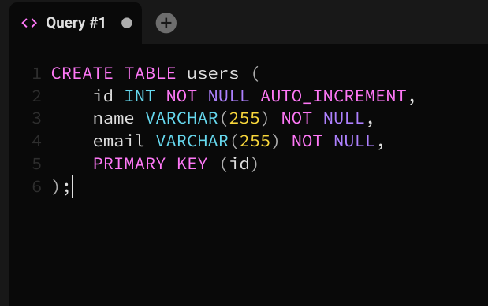
Creating Users Table
Let’s create the users table first.
Each user will have the following fields(columns):
name: The name of the user
email: The email of the user
Tips: whenever working with a database, always start with the users table first, this way you can visualize the relationship to other entities easily. (eg: users can create many books, recipes, etc)

Slide 21
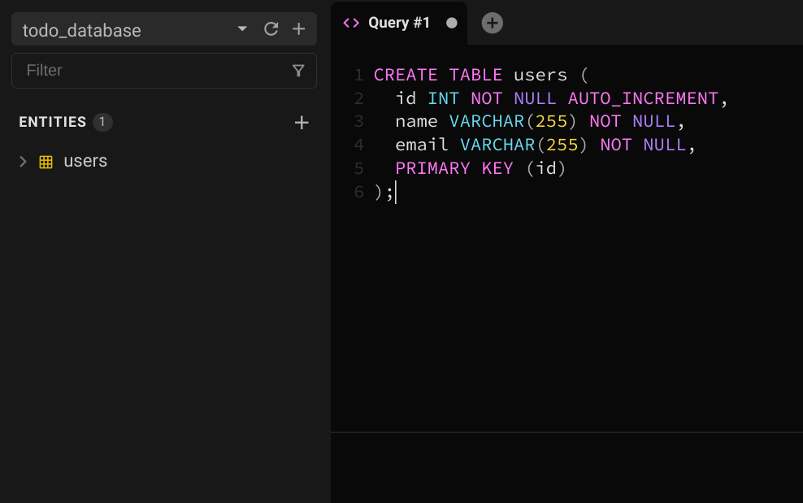
Execute the command…
Hit CTRL + Enter on your keyboard or click run at the middle right to execute the command. You will notice it a new list labeled users appear at the left section.

Slide 22
Let’s understand what previous command did
CREATE TABLE users: create a new table in the database named "users".
id INT: creates a column in the table named id with the type of integer.
name VARCHAR(255) and email VARCHAR(255): creates a column in the table named “name” and “email” with the type of string. The 255 means that you can store up to 255 characters.
NOT NULL: means a column must always have a value - it can't be left empty.

Slide 23
Let’s understand what previous command did
AUTO_INCREMENT: means that the value in this column will automatically increase by 1 for each new record. This is commonly used for primary keys.
PRIMARY KEY (id): This defines "id" as the primary key of the table. A primary key is a special relational database table column (or combination of columns) designated to uniquely identify all table records. Here, it means that no two "users" can have the same "id".
When creating a table, first specify its name, then define its columns with their names and data types.
When creating a column in a table, the column name must start first then followed by the data type.

Slide 24
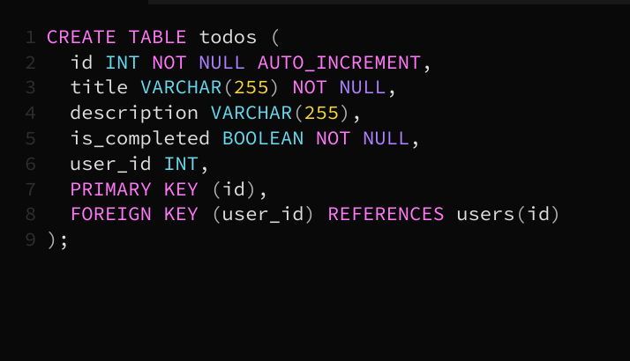
Creating Todos Table
Let’s create the todos table now.
Each todo will have the following fields(columns):
title: The title of the todo
is_completed: Whether the todo has completed or not
user_id: The id of the user who created it. It has a foreign key relation to the users table that will associate the todo row to the user

Slide 25
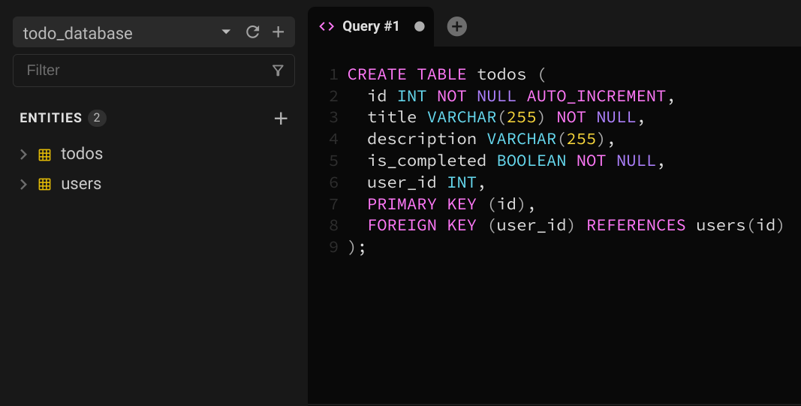
Execute the command…
Hit CTRL + Enter on your keyboard or click run at the middle right to execute the command. You will notice it a new list labeled todos appear at the left section.

Slide 26
Let’s understand what previous command did
CREATE TABLE users: create a new table in the database named "todos".
id INT: creates a column in the table named id with the type of integer.
title VARCHAR(255) NOT NULL: creates a non-nullable column in the table named “title” with the type of string. The 255 means that you can store up to 255 characters.
description VARCHAR(255): creates a column in the table named “description” with the type of string. You’ll notice that we left out NOT NULL keyword. Hence, this column can be nullable.
user_id VARCHAR(255): creates a column in the table named “user_id” with the type of integer. This column will store the id of the user who created the todo.

Slide 27
Let’s understand what previous command did
AUTO_INCREMENT: means that the value in this column will automatically increase by 1 for each new record. This is commonly used for primary keys.
PRIMARY KEY (id): This defines "id" as the primary key of the table. A primary key is a special relational database table column (or combination of columns) designated to uniquely identify all table records. Here, it means that no two "todos" can have the same "id".
FOREIGN KEY (user_id) REFERENCES users(id): This defines a foreign key relationship to users table through the “user_id” column.

Slide 28
What’s a foreign key?
A "foreign key" is a field in a table that links to the primary key in another table. It's a way to ensure that the data in the table is consistent and that there are valid links between tables.
In this case, each "todo" is associated with a user in the "users" table through the "user_id". The foreign key ensures that for every "todo", the "user_id" corresponds to a valid "id" in the "users" table.

Slide 29
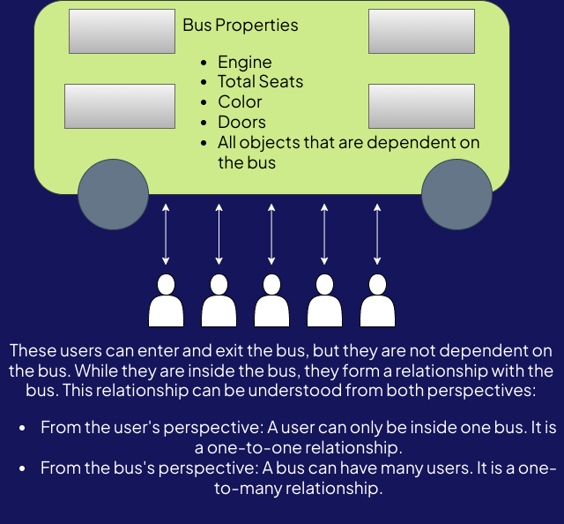
Foreign Keys/References/Relationships

Slide 30
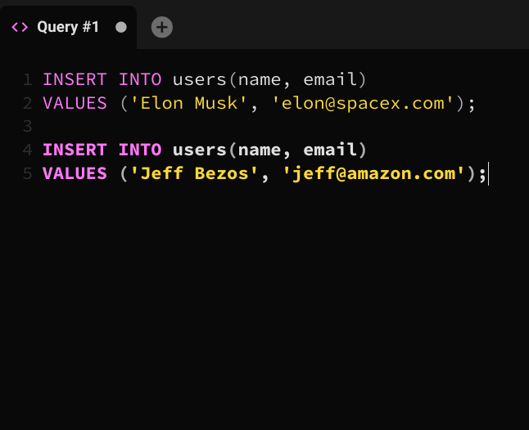
Using Basic SQL commands: INSERT
So far we have two tables but we haven’t inserted any data to these tables yet. Let’s try inserting some. To insert/create a new row, we use a command called “INSERT INTO table_name”, followed by the values. Let’s create some users first. INSERT INTO users(name, email)
VALUES ('Elon Musk', 'elon@spacex.com');
INSERT INTO users(name, email)
VALUES ('Jeff Bezos', 'jeff@amazon.com');
This will create two users in the users table.

Slide 31
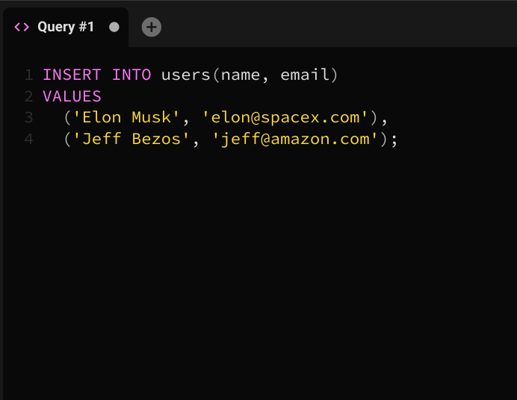
Using Basic SQL commands: INSERT
We can also combine these commands into one as follow: INSERT INTO users(name, email)
VALUES
('Elon Musk', 'elon@spacex.com'),
('Jeff Bezos', 'jeff@amazon.com');
Same as before, it will create two users.

Slide 32
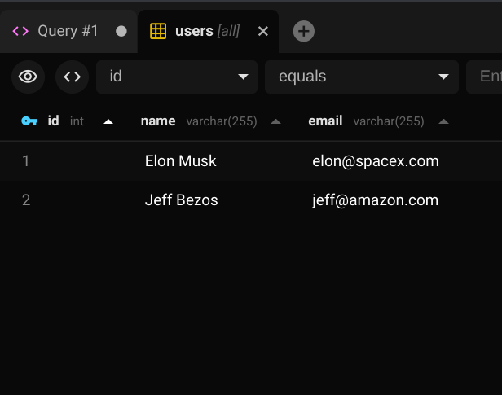
Let’s check the users table now
You can double click on the icon labeled users in the left section. We have two users now.

Slide 33
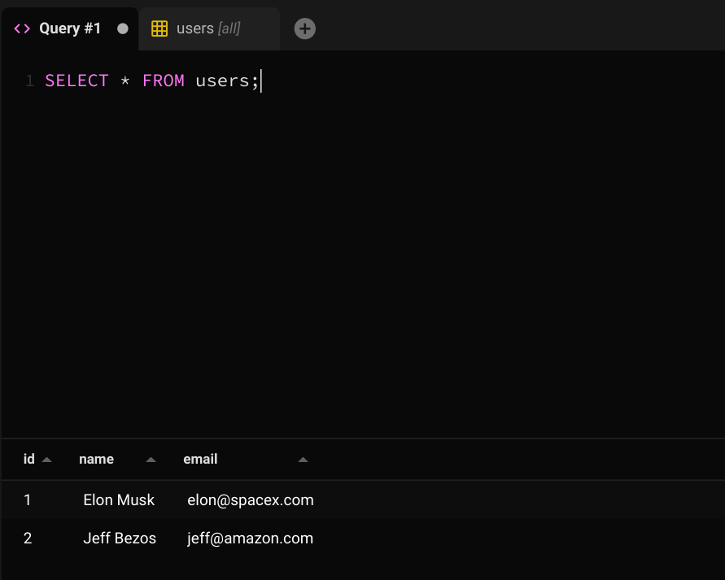
Using Basic SQL commands: SELECT
You can also use SELECT command to read from a table.
SELECT * FROM users;
This will select all users. (Be careful! Do not use this command a lot. It’s fine if you have a few rows in the table but with large amount of rows, this can slow down the database. Use 'LIMIT' for efficiency and to control the number of returned rows)

Slide 34
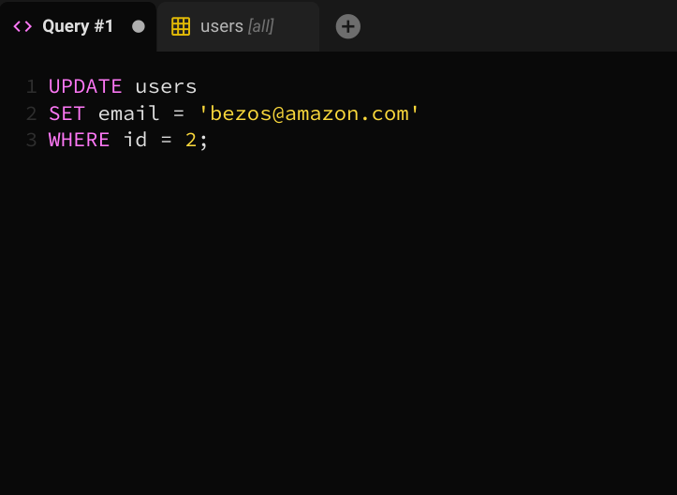
Using Basic SQL commands: UPDATE
Uh oh! Looks like Jeff gave us the wrong email! We need to update his email. How can we do that? Well, you can use UPDATE and update the column(s) you want. In this case, we just want to update the email of this user:
UPDATE users
SET email = ‘bezos@amazon.com’
WHERE id = 2;
This will select the user with an id of 2 and update the email. Be careful! If you omit WHERE clause, this command will update every single row in the table. Do not forget WHERE clause when updating row(s).

Slide 35
Using Basic SQL commands: DELETE
We can delete the row(s) with the DELETE command as follow:
DELETE FROM users WHERE id = 2;
This will delete the user with an id of 2l. Be careful! If you omit WHERE clause, this command will delete all rows in the table. Do not forget WHERE clause when deleting row(s).

Slide 36
Your turn…
Delete all users from the users table.
Create two new users.
Create two todos for each user.

Slide 37
Self Cover: Intro to Databases Up until SQL Query ~ GROUP BY & HAVING queries

Slide 38
Task of the day Create ERD diagram for the todoapp with lucidchart or miro or on whiteboard.

Slide 39
Task of the day 2 Create the required entities and attributes for the following application:
You are asked to build a database for the car application
There are two users type in this app. Sellers and buyers. Sellers can sell their cars and buyers can buy cars.
Sellers are able to create/update/delete cars
Each car should have the basic information about the car such as brand, model, make, name, vehicle number, whether the vehicle has been sold or not.
A vehicle can be sold to one unique buyer. No two users can buy the same vehicle.
Once a vehicle is sold, a transaction record should be available.

Slide 40
Take home tasks

Slide 41
Some homework 📚
Code Along Project 2
Assignment 2

Slide 42
References
What is Docker and how to use it?
SQL Commands Cheatsheet
How to draw ERD?

